Slide 1

Build cloud agnostic apps using the Serverless Framework

Slide 2
Presenter
Desiree Suligan
Developer – IoT and Integration
Datacom NZ
DesireeS@datacom.co.nz

Slide 3


Slide 4

Cloud Native vs. “Cloud Agnostic”

Slide 5


Containerization and Serverless Framework

Slide 6
Demo

Slide 7
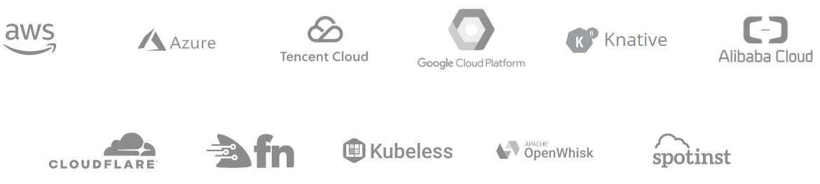
Providers

Slide 8
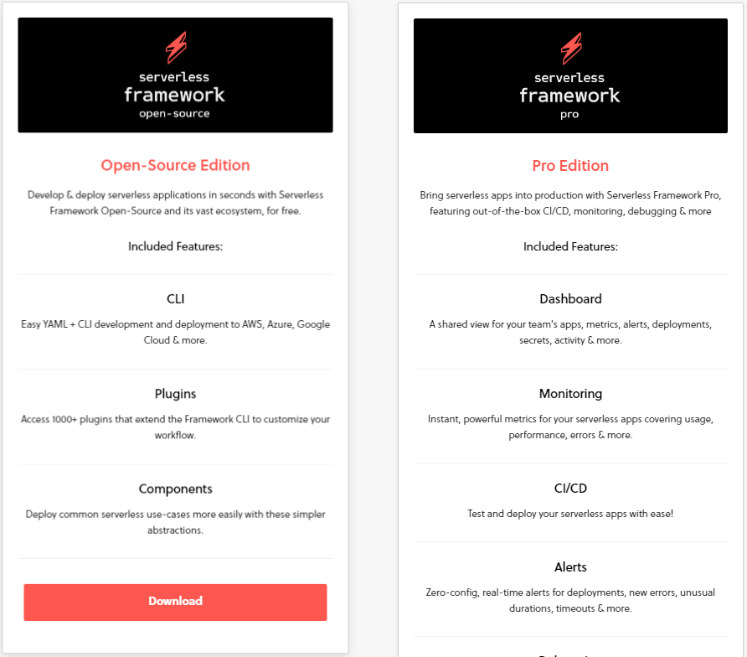
Versions and Pricing Tiers

Slide 9
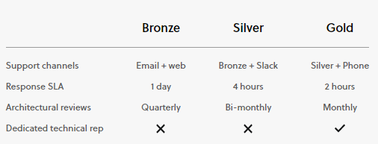
Support and Training Add-Ons

Slide 10

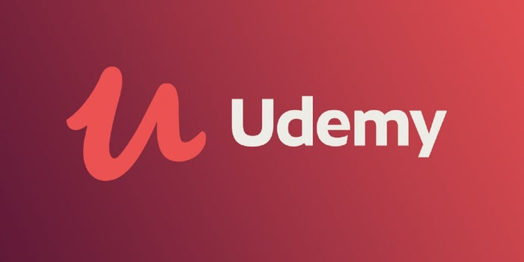
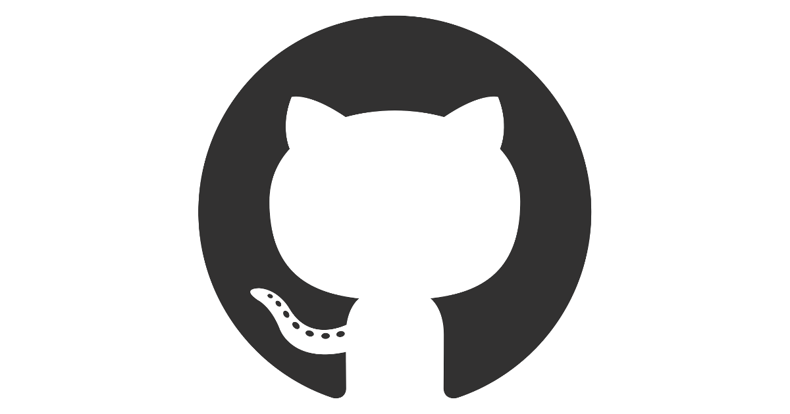

Setup, Training and Documentation

Slide 11
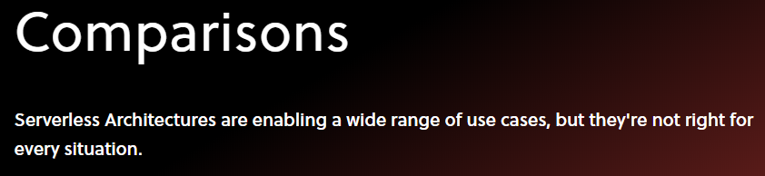
When to use the Serverless Framework?
Source: serverless.com/learn/comparisons/

Slide 12

A few things to keep in mind…

Slide 13


Slide 14



Reference material
https://serverless.com/
https://www.finextra.com/blogposting/16840/cloud-native-vs-cloud-agnostic-what-conundrum-behind-the-hype
https://serverless-stack.com/chapters/what-is-serverless.html
https://blog.iron.io/strategies-for-cloud-agnostic-architectures/
https://medium.com/@TechMagic/serverless-vs-docker-what-to-choose-in-2019-80cb80f4b680
https://avinetworks.com/glossary/container-deployment/

